Slide 1
static void Main()
{
bool complete = false;
var t = new Thread(() =>
{
int i=0;
while (!complete)
i++;
Console.Write(i);
});
t.Start();
Thread.Sleep(1000);
complete = true;
t.Join();
}
run it with optimizations enabled and Release Mode
Notes:
This program never terminates because the complete variable is cached in a CPU register.

Slide 2
class Foo
{
int _answer;
bool _complete;
void A()
{
_answer = 123;
_complete = true;
}
void B()
{
if(_complete)
{
Console.WriteLine (_ answer);
}
}
}

Slide 3
class Foo
{
int _answer;
bool _complete;
void A()
{
_answer = 123;
_complete = true; //← instructions could get reordered causing B to write “0”
}
void B()
{
if (_complete)
Console.WriteLine (_answer);
}
}
Notes:
compilers/CPU could translate the code in such a way as to reverse the two lines of code

Slide 4
static void Main()
{
bool complete = false;
var t = new Thread(() =>
{
int i=0;
while (!complete)
{
Thread.MemoryBarrier();
i++;
}
Console.Write(i);
});
t.Start();
Thread.Sleep(1000);
complete = true;
t.Join();
}
run it with optimizations enabled and Release Mode
Notes:
Forces any earlier program order (the way it was written) loads and stores to be completed before the call to MemoryBarrier And it also forces any later program-order loads and stores to be completed after the call

Slide 5

Volatile
Tells the C# and JIT compilers not to cache the field in a CPU register, ensuring that all reads to and from the field actually cause the value to be read from memory
Notes:
In finance, volatility is a measure for variation of price of a financial instrument over time

Slide 6
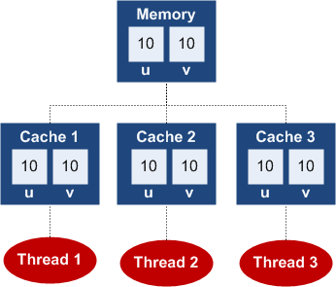
Notes:
Consider a simple example with a non-volatile memory location (i.e. a field) u, and a volatile memory location v.

Slide 7
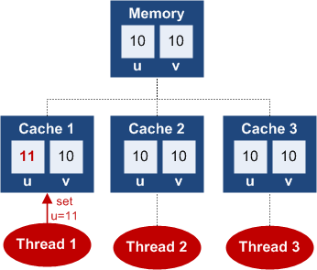
Notes:
A non-volatile write could just update the value in the thread’s cache, and not the value in main memory:However, in C# all writes are volatile (unlike say in Java), regardless of whether you write to a volatile or a non-volatile field. So, the above situation actually never happens in C#.

Slide 8
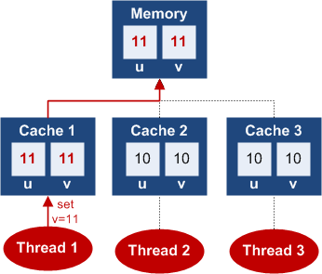
all C# writes are volatile
Notes:
A volatile write updates the thread’s cache, and then flushes the entire cache to main memory. If we were to now set the volatile field v to 11, both values u and v would get flushed to main memory:
Since all C# writes are volatile, you can think of all writes as going straight to main memory.

Slide 9
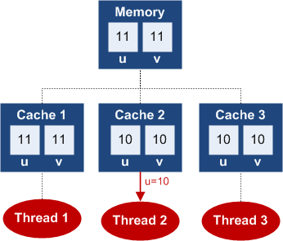
Notes:
A regular, non-volatile read can read the value from the thread’s cache, rather than from main memory. Despite the fact that thread 1 set u to 11, when thread 2 reads u, it will still see value 10:
When you read a non-volatile field in C#, a non-volatile read occurs, and you may see a stale value from the thread’s cache. Or, you may see the updated value. Whether you see the old or the new value depends on your compiler and your processor.

Slide 10
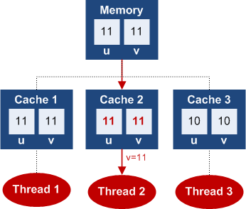
Notes:
Finally, let’s take a look at an example of a volatile read. Thread 2 will read the volatile field v:
Before the volatile read, thread 2 refreshes its entire cache, and then reads the updated value of v: 11. So, it will observe the value that is really in main memory, and also refresh its cache as a bonus.

Slide 11

The compiler, CLR, or CPU may reorder your program's instructions to improve efficiency.

Slide 12
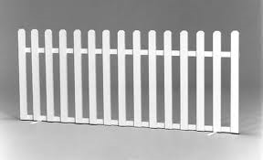
fences
Prevents any kind of instruction reordering or caching around that fence.
Notes:
This typically means that certain operations are guaranteed to be performed before the barrier, and others after.

Slide 13
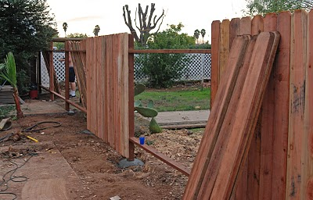
Acquire fence
A memory barrier in which other reads & writes are not allowed to move before the fence.

Slide 14

Release fence
A memory barrier in which other reads & writes are not allowed to move after the fence.

Slide 15
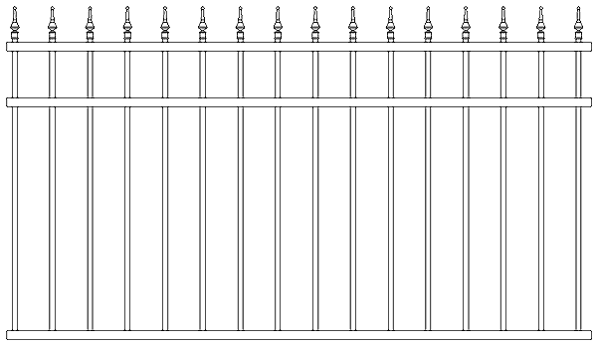
Half fence v/s Full fence
A memory barrier that creates only one of two is sometimes called a half-fence. A memory barrier that creates both is sometimes called a full-fence.

Slide 16
class Foo
{
int _answer;
bool _complete;
void A()
{
_answer = 123;
Thread.MemoryBarrier(); // Barrier 1 –
//writes you have before the fence must complete before the fence
_complete = true;
Thread.MemoryBarrier(); // Barrier 2
}
void B()
{
Thread.MemoryBarrier(); // Barrier 3
//any variable reads after the fence must start after it.
if (_complete)
{
Thread.MemoryBarrier(); // Barrier 4
Console.WriteLine (_answer);
}
}
}

Slide 17
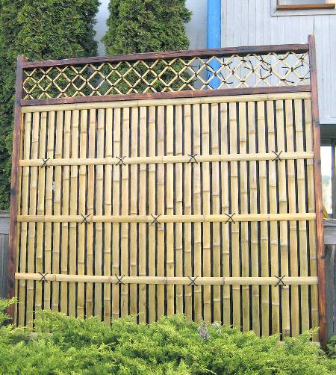
Volatile (half fence)
The volatile keyword instructs the compiler to generate an acquire-fence on every read from that field, and a releasefence on every write to that field.

Slide 18
class CA
{
volatile int x, y;
void Test1() // Executed on one thread
{
x = 1; // Volatile write (release-fence)
int a = y; // Volatile read (acquire-fence)
...
}
void Test2() // Executed on another thread
{
y = 1; // Volatile write (release-fence)
int b = x; // Volatile read (acquire-fence)
...
}
}
This presents a strong case for avoiding volatile
Inst #1 | Inst #2 | Can they be swapped
Read | Read | No
Read | Write | No
Write | Write | No
Write | Read | Yes !
Notes:
if Test1 and Test2 run simultaneously on different threads, it’s possible for a and b to both end up with a value of 0. The MSDN documentation states that use of the volatile keyword ensures that the most up-to-date value is present in the field at all times. This is incorrect, since as we’ve seen, a write followed by a read can be reordered.

Slide 19
Construct | Purpose | Crossprocess? | Overhead*
lock (Monitor.Enter / Monitor.Exit) | Ensures just one thread can access a resource |  | 20ns
Mutex |  | Yes | 1000ns
SemaphoreSlim (4.0) | Ensures not more than a specified number of concurrent threads can access a resource |  | 200ns
Semaphore |  | Yes | 1000ns
ReaderWriterLockSlim (3.5) | Allows multiple readers to coexist with a single writer |  | 40ns
ReaderWriterLock (deprecated) |  |  | 100ns
*Time taken to lock and unlock the construct once on the same thread (assuming no blocking), as measured on an Intel Core i7 860.

Slide 20
Construct | Purpose | Crossprocess? | Overhead*
AutoResetEvent | Allows a thread to unblock once when it receives a signal from another | Yes | 1000ns
ManualResetEvent | Allows a thread to unblock indefinitely when it receives a signal from another (until reset) | Yes | 1000ns
ManualResetEventSlim(4.0)
 |  |  | 40ns
CountdownEvent (4.0) | Allows a thread to unblock when it receives a predetermined number of signals |  | 40ns
Barrier (4.0) | Implements a thread execution barrier |  | 80ns
Wait and Pulse | Allows a thread to block until a custom condition is met |  | 120ns for a Pulse
*Time taken to signal and wait on the construct once on the same thread (assuming no blocking), as measured on an Intel Core i7 860.

Slide 21
Construct | Refreshes thread cache before? | Flushes thread cache after? | Notes
Ordinary read | No | No | Read of a non-volatile field
Ordinary write | No | Yes | Write of a non-volatile field
Volatile read | Yes | No | Read of volatile field, or Thread.VolatileRead
Volatile write | No | Yes | Write of a volatile field – same as non-volatile
Thread.MemoryBarrier | Yes | Yes | Special memory barrier method
Interlocked operations | Yes | Yes | Increment, Add, Exchange, etc.
Lock acquire | Yes | No | Monitor.Enter or entering a lock {} region
Lock release | No | Yes | Monitor.Exit or exiting a lock {} region

Slide 22


Slide 23
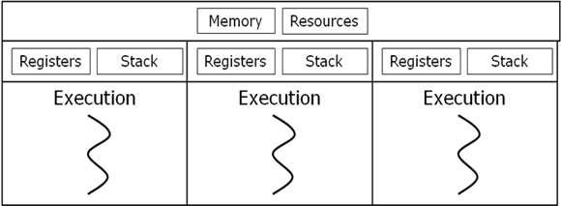
Notes:
Multi-threading : Same job can be broken logically and executed simultaneously and the results are combined at the end of processing
Threads share the same address space and Context switching between threads is less expensive

Slide 24
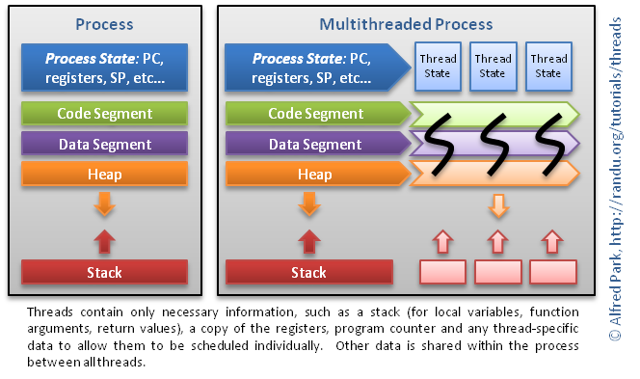

Slide 25

Race Conditions
A race condition is a bug that occurs when the outcome of a program depends on which of two or more threads reaches a particular block of code first.

Slide 26

The CLR, in a standard hosting environment, is not like SQL Server and does not automatically detect and resolve deadlocks by terminating one of the offenders.

Slide 27
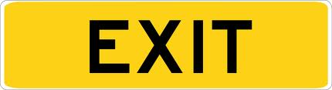
If you cannot ensure that Monitor.Exit will be called, consider changing your design to use Mutex.
Notes:
A mutex is automatically released when the thread that currently owns it terminates.
If using Monitor class to synchronize, ensure that Monitor.Exit is always called

Slide 28

If you ever need to acquire two locks at once, document the ordering thoroughly and make sure you always use the same order.

Slide 29

torn read
So, if thread X reads a 64-bit value while thread Y is updating it, thread X may end up with a bitwise combination of the old and new values

Slide 30
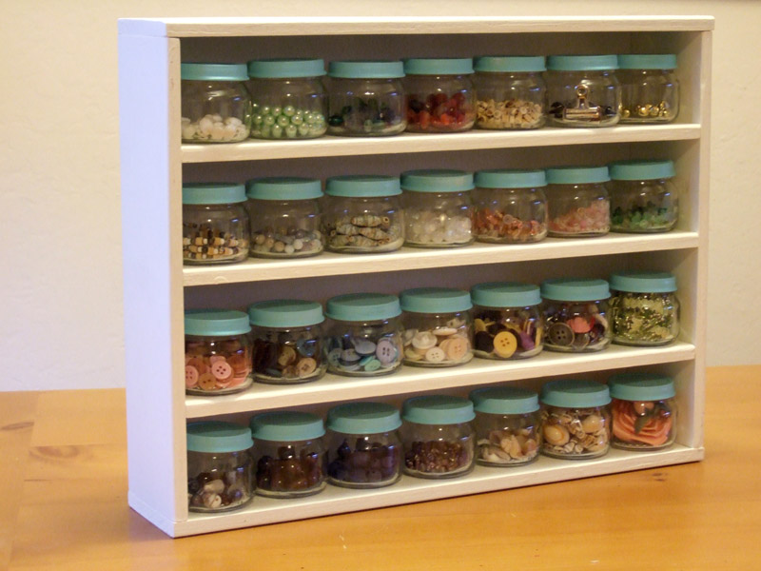
The compiler, CLR, or CPU may introduce caching optimizations such that assignments to variables won't be visible to other threads right away.

Slide 31

Never lock 'this' or other public properties.
Notes:
In general, it's a very bad idea to rely on locking an object you didn't create and don't know who else might be accessing. Doing so invites deadlock.

Slide 32

Reference to a static variable should be synchronized using a thread lock.

Slide 33
The deprecated Suspend and Resume methods have two modes: dangerous and useless!
Notes:
If a thread holding a lock on a critical resource is suspended, the whole application can deadlock.

Slide 34
Do not abort a thread. Implement a cooperative cancellation pattern

Slide 35
public StreamWriter (string path, bool append, ...)
{
...
...
Stream stream1 = StreamWriter.CreateFile (path, append);
this.Init (stream1, ...);
}
if the Abort fires anywhere within the nit method, the newly created stream will be abandoned, with no way of closing the underlying file handle.
Notes:
Ending Application Domains
Ending Processes

Slide 36
Synchronization constructs
Simple blocking methods
These wait for another thread to finish or for a period of time to elapse.
Locking constructs
These limit the number of threads that can perform some activity or execute a section of code at a time.
Signaling constructs
These allow a thread to pause until receiving a notification from another
Nonblocking synchronization constructs
These protect access to a common field by calling upon processor primitives.

Slide 37
Simple blocking methods
Sleep
Join
Task.Wait .
Locking constructs
Exclusive locking
lock (Monitor.Enter/Monitor.Exit),
Mutex,
SpinLock.
nonexclusive locking
Semaphore
SemaphoreSlim
reader/writer locks.
Signaling constructs
event wait handles
Monitor’s Wait/Pulse methods.
CountdownEvent
Barrier classes.
Nonblocking synchronization constructs
Thread.MemoryBarrier,
Thread.VolatileRead,
Thread.VolatileWrite,
volatile keyword
Interlocked class.
Notes:
Exclusive locking constructs are most common—these allow just one thread in at a time, and allow competing threads to access common data without interfering with each other.

Slide 38
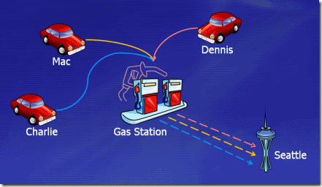
Barrier

Slide 39


Count Down Event
Notes:
CountdownEvent is designed for scenarios in which you would otherwise have to use a ManualResetEvent or ManualResetEventSlim and manually decrement a variable before signaling the event. For example, in a fork/join scenario, you can just create a CountdownEvent that has a signal count of 5, and then start five work items on the thread pool and have each work item call Signal when it completes. Each call to Signal decrements the signal count by 1. On the main thread, the call to Wait will block until the signal count is zero.

Slide 40
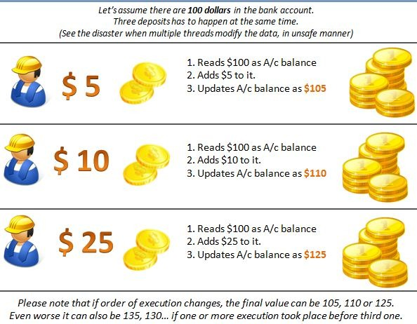

Slide 41
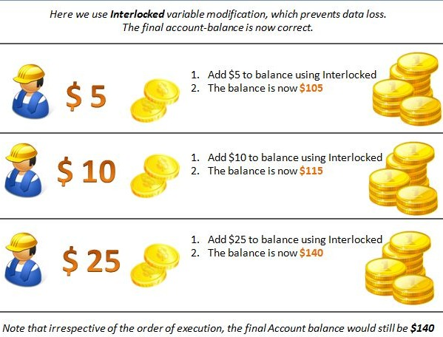
This is safe, as it effectively does the read, increment,
and write in 'one hit' which can't be interrupted.

Slide 42
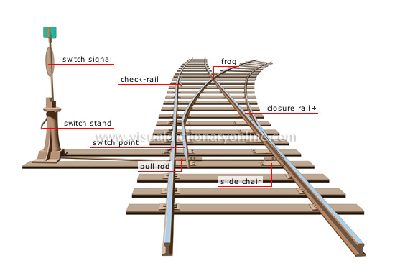
Sleep(0) v/s Yield
Causes the calling thread to yield execution to another thread that is ready to run on the current processor. The operating system selects the thread to yield to.
Notes:
voluntarily handing over the CPU to other threads.
If this method succeeds, the rest of the thread's current time slice is yielded. The operating system schedules the calling thread for another time slice, according to its priority and the status of other threads that are available to run.
Yielding is limited to the processor that is executing the calling thread. The operating system will not switch execution to another processor, even if that processor is idle or is running a thread of lower priority. If there are no other threads that are ready to execute on the current processor, the operating system does not yield execution, and this method returns false.
This method is equivalent to using platform invoke to call the native Win32 SwitchToThread function. You should call the Yield method instead of using platform invoke, because platform invoke bypasses any custom threading behavior the host has requested.

Slide 43

Blocking Versus Spinning
Avoids the cost of context switching
and kernel transitions.
Notes:
Blocking (pause)
pauses the current thread
spinning (uselessly busy)
Effective when you expect a condition to be satisfied soon.
Their main use is in writing custom synchronization constructs.

Slide 44

Join v/s Sleep
Wait for another thread to end by calling its Join method.
Notes:
Thread.Sleep pauses the current thread for a specified period

